Slide 1
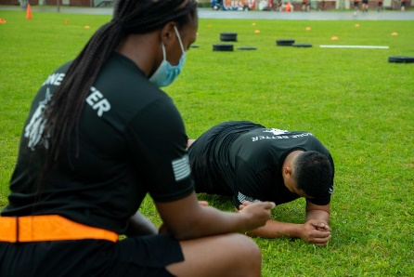
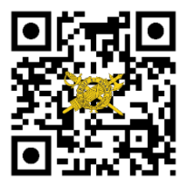
THE
Your Unit
Patch / Crest
Here.
IG UPDATE
Volume 21-3, April 2021
Update to the Army’s Combat Fitness Test — ACFT 3.0
On 22 March 2021, Sgt. Maj of the Army, Michael A. Grinston, released an SMA sends formally announcing the release of the Army Combat Fitness Test (ACFT ) 3.0 to the Total Army. This adaptation of the ACFT (effective 1 April) includes six events (3-Repetition Maximum Deadlift, Standing Power Throw, Hand-Release Push-Ups, Sprint-Drag-Carry, Leg Tuck or Plank, and 2-Mile Run), with one significant change that adds the Plank as a full 100-point alternative to the Leg Tuck for Soldier’s core strength test event.
In addition to this change, ACFT 3.0 explores the establishment of an evaluation system with performance categories that may be used to proportionally tier ACFT performance according to gender. These proposed performance tiers include:
Platinum (top 1 percent; female/male);
Gold (top 2-10 percent; female/male);
Silver (top 11-25 percent; female/male);
Bronze (top 26-50 percent; female/male); and
Green (Soldiers who pass the ACFT, but do not place in the top 50 percent of scores across the Total Army.)
Under ACFT 3.0, these performance categories would be calculated annually based upon ACFT scores from across the force. Categorizing scores into tiers allows for variations in height, weight, test conditions, slope, surface, etc., and further recognizes physiological differences between men and women, while fostering and recognizing above-average physical performance.
While the Army expects to fully implement the ACFT in 2022, policy changes will only be finalized when sufficient data exists for Army senior leaders to make informed decisions. Until then, ACFT scores will not be linked to a Soldier’s record in any Army personnel system, and as Army Directive 2020-06 stated, leaders will not take adverse administrative actions for or against Soldiers on the basis of their ACFT performance.
In addition to these changes, Soldiers and leaders should be aware of the following:
All Active-duty Soldiers should take two ACFTs for data collection by 1 October 2021, while Reserve Component Soldiers should take at least one record ACFT before 1 October 2021.
The ACFT is a training requirement in Initial Military Training, but not a graduation requirement.
Soldiers with a permanent profile should execute any events their profile permits. Soldiers on a temporary profile that prevents a full six-event ACFT should recover, rehabilitate, recondition, and then complete a full ACFT.
During FY21, Soldiers attending institutional training courses that require a physical fitness test as an entrance requirement should use their last record APFT score. However, functional course commandants may continue to establish their own course-specific physical performance requirements.
The Army remains committed to the health and safety of Soldiers and encourages Soldiers to maintain physical fitness while continuing to follow COVID-19-related safety practices (washing hands, maintaining social distancing, wearing masks).
Sgt. Henry Lugo, a human resources specialist assigned
to 3rd IBCT, 25th Infantry Division, conducts the newly
revised plank event while taking the ACFT at
Schofield Barracks, Hawaii on March 24, 2021
Your Unit Name Here
Commanding General
MG Soldier Q. Public
Command Sergeant Major
CSM Soldier Q. Public
Command Inspector General
LTC Soldier Q. Public
Inspector General NCOIC
SGM Soldier Q. Public
IG Points of Contact
Unit IG Office
Building 1234
Hooah Drive
Fort Swampy LA 55555
Unit IG Website
http:\IG-bla-bla-bla.mil
Unit IG Office Email
IG-bla-bla@mail.mil
Unit IG Hotline
555-555-5555
Unit IG Office
555-555-5555
References
SMA Sends (ACFT), 22 March 2021.
Army Directive 2020-06 (Army Combat Fitness Test), 12 June 2020.
HQDA EXORD 219-18 (Army Combat Fitness Test), 13 July 2018, and associated FRAGOs)
Resources
www.army.mil/ACFT
ACFT PRT App (Available on Android and iOs).
ig.army.mil

